Slide 1

Analysis of Positive West Nile Virus Cases in California
Sebastian Gutierrez-Olvera

Slide 2
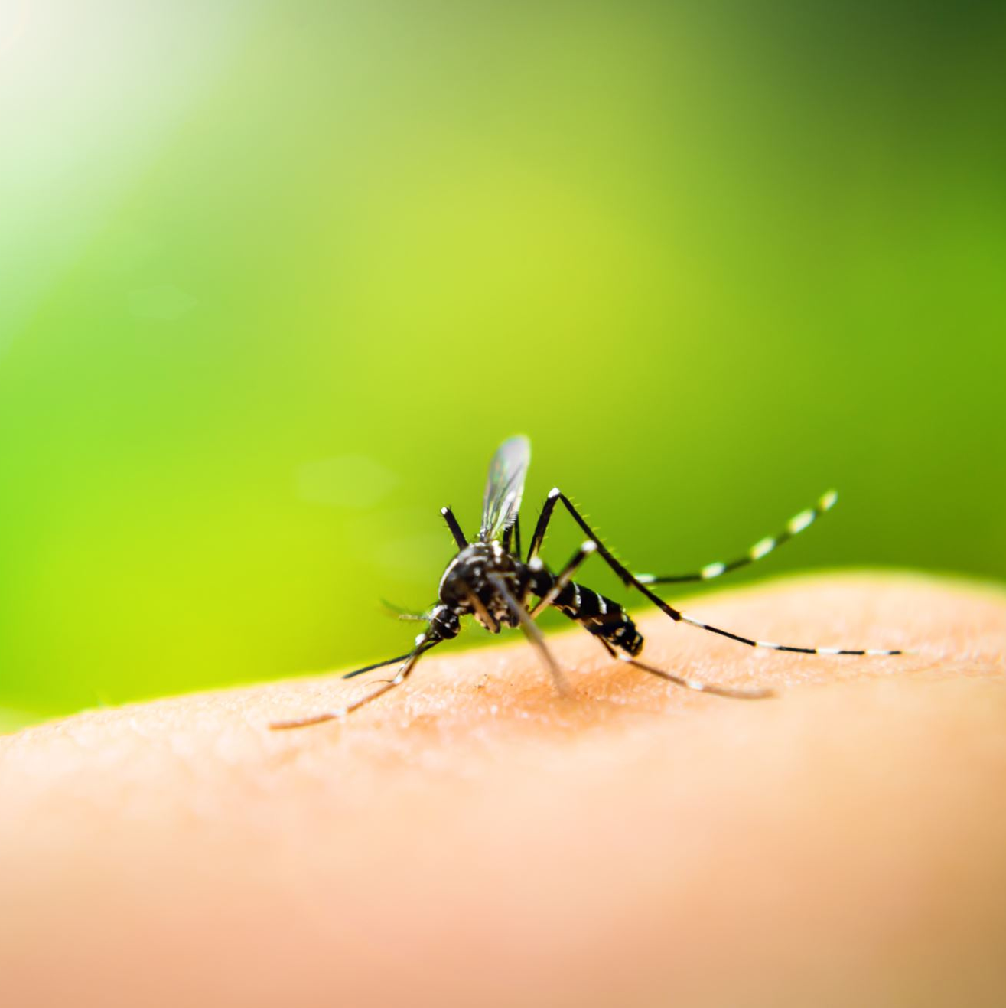
Background
West Nile is most often spread through mosquito bites
1 in 5 people infected develop a fever and other symptoms
1 in 150 infected people will develop a serious, possibly fatal illness
Rarely transmitted from person to person
2012 was marked by a national outbreak
Source: www.cdc.gov/west-nile-virus/about/index.html

Slide 3


The Data Set
Roughly 1500 data points collected from 2006 to 2016
Each year reported contained week reported, number of cases and what county the case was reported from
Chose mainly to focus on the weekly distribution

Slide 4
hypothesis
2012 was the worst year for California in terms of number of positive cases of West Nile Virus.

Slide 5
question
Big Question: Was the national outbreak in 2012 the worst moment for California when dealing with West Nile Virus?
First ANOVA will tell us if there is significant variance between the years to proceed further with this question
If results from the ANOVA show that yes there is significant variance, t-tests can be used to find which years specifically were outside of the range and then we can compare them

Slide 6
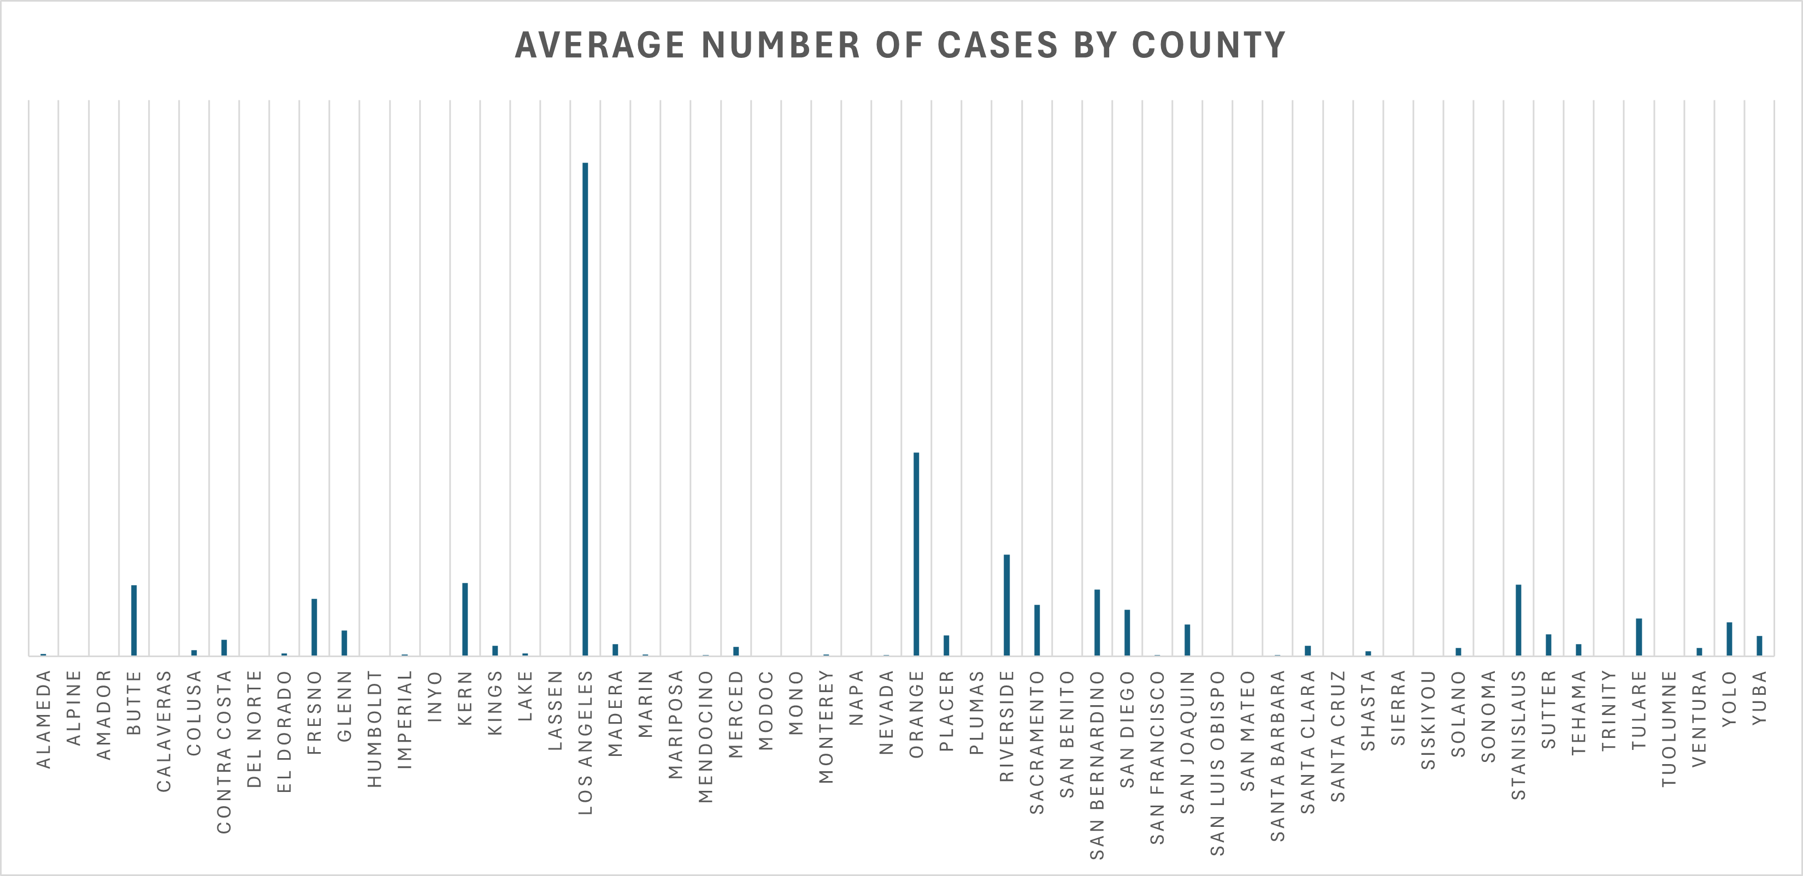

Slide 7
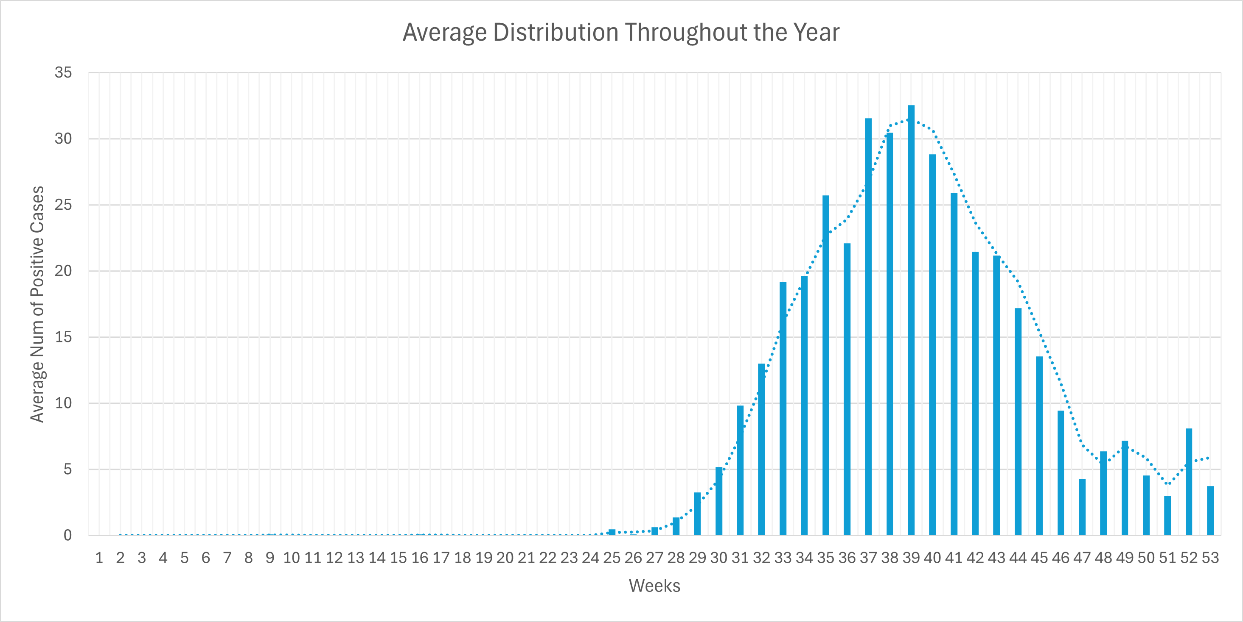

Slide 8
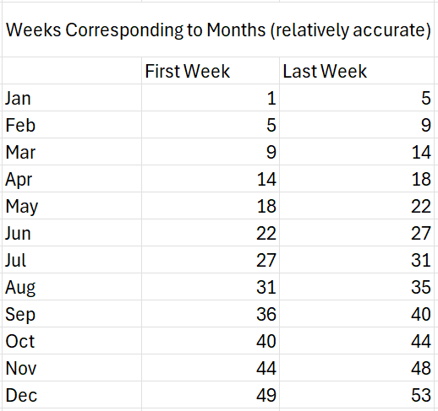
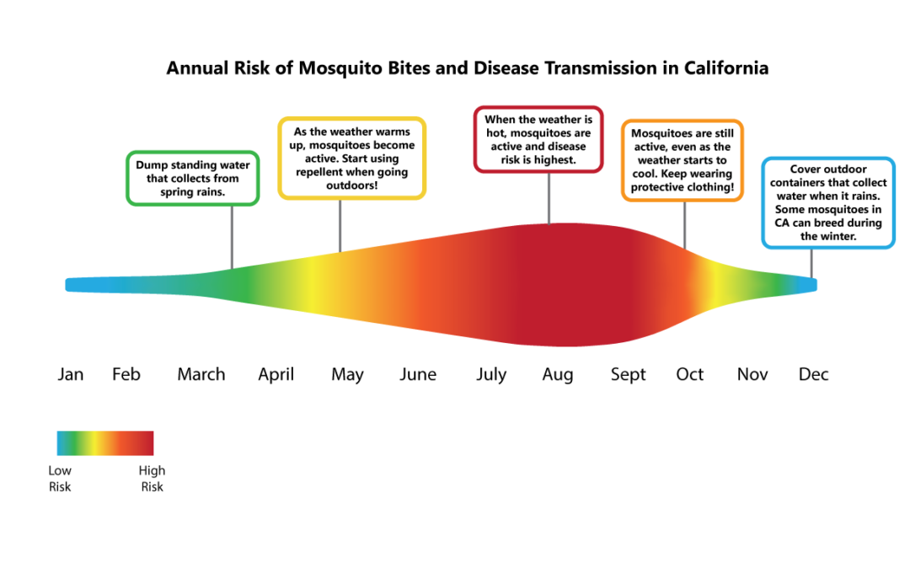
Source: www.cdph.ca.gov

Slide 9
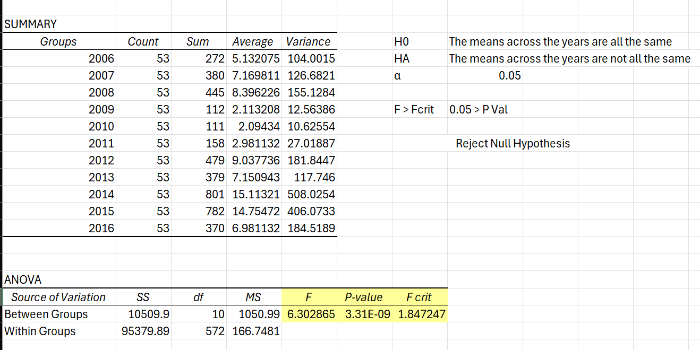

Slide 10
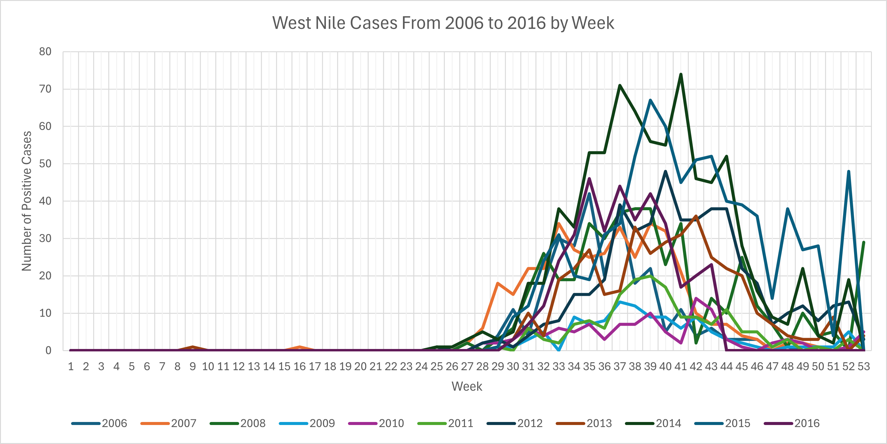

Slide 11
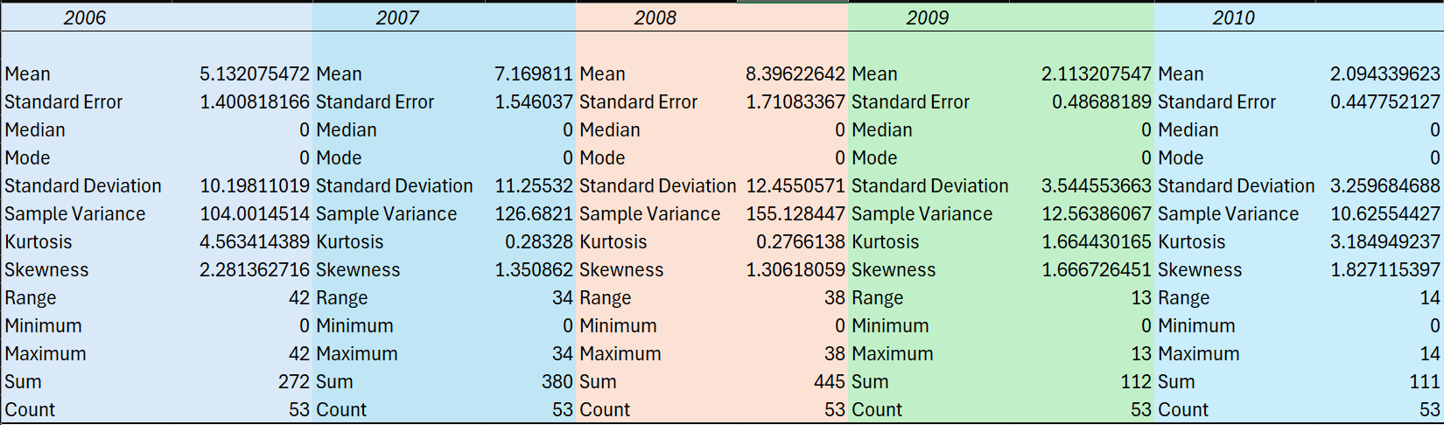
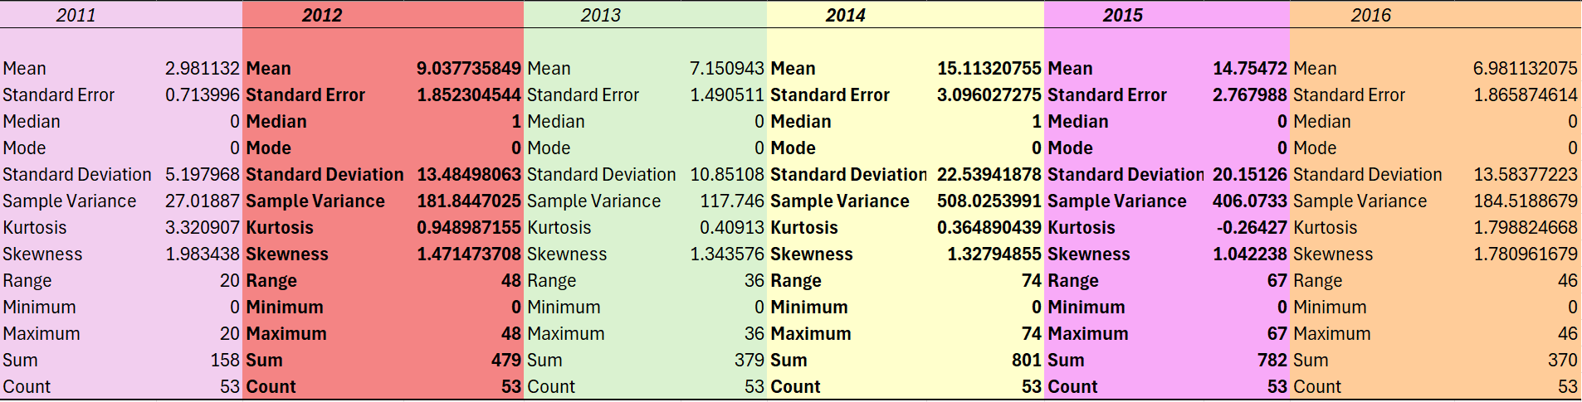

Slide 12
Further Testing
3 Years of Concern 2012, 2014, 2015
T-tests were run on all three by taking them out of the average and then comparing them via a paired t-test for two sample means

Slide 13
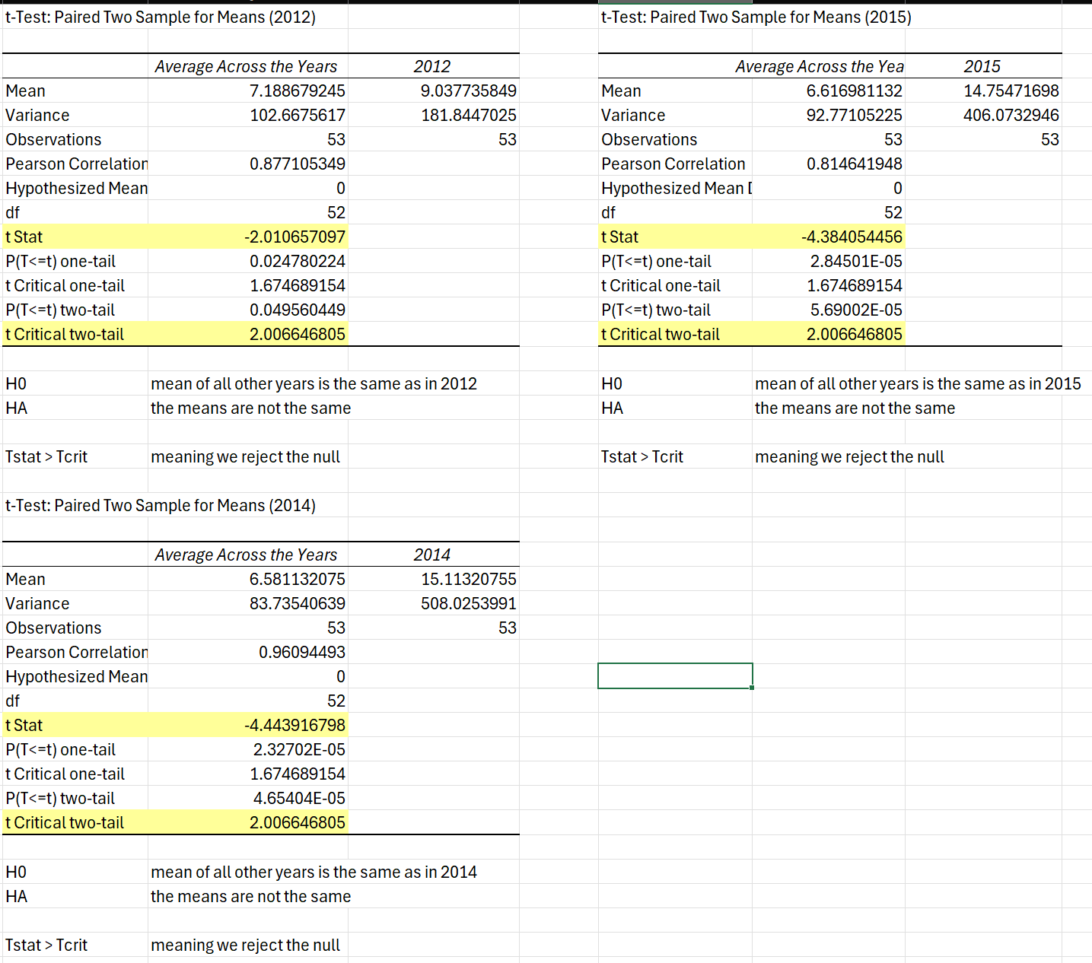

Slide 14
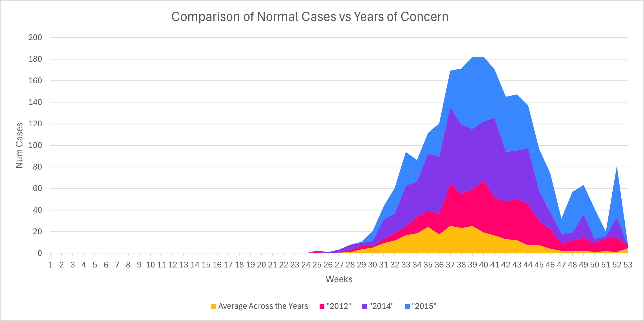

Slide 15
Results
All 3 years of concern were outside of the average for California.
Interestingly, 2012 was not bad when compared to 2014 and 2015.
The spikes in the level of cases from 2014 – 2015 were drastic enough that 2012 got closer to the moving average for cases.
2015 was by far the worst year for positive cases
September is when the most positive cases for West Nile Virus occur at least in California from 2006 to 2016

Slide 16
Comparison to nation
The following slides show data from the CDC reporting cases of WNV during 2012, 2014, 2015.
These reports do highlight just how bad 2012 actually was nationally.
This could suggest that California had a very good prevention campaign in 2012 since our data did not suggest 2012 was as bad as initially thought

Slide 17
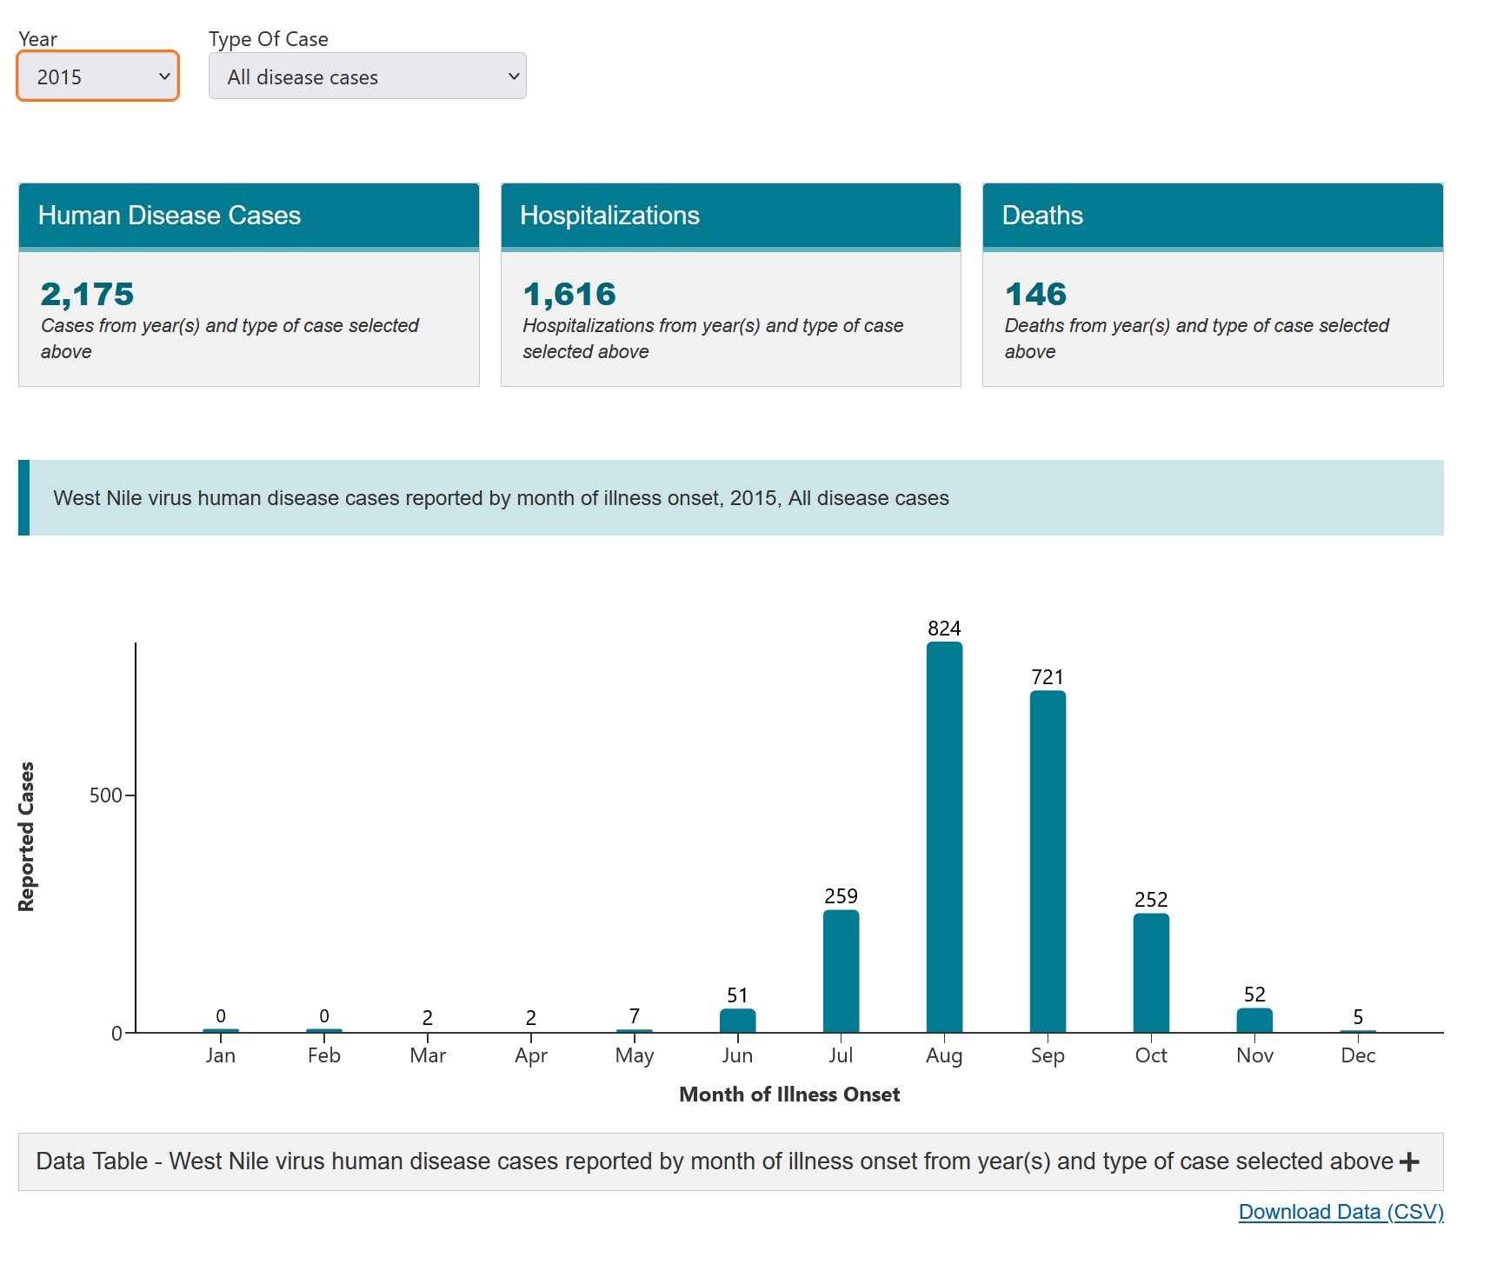

Slide 18
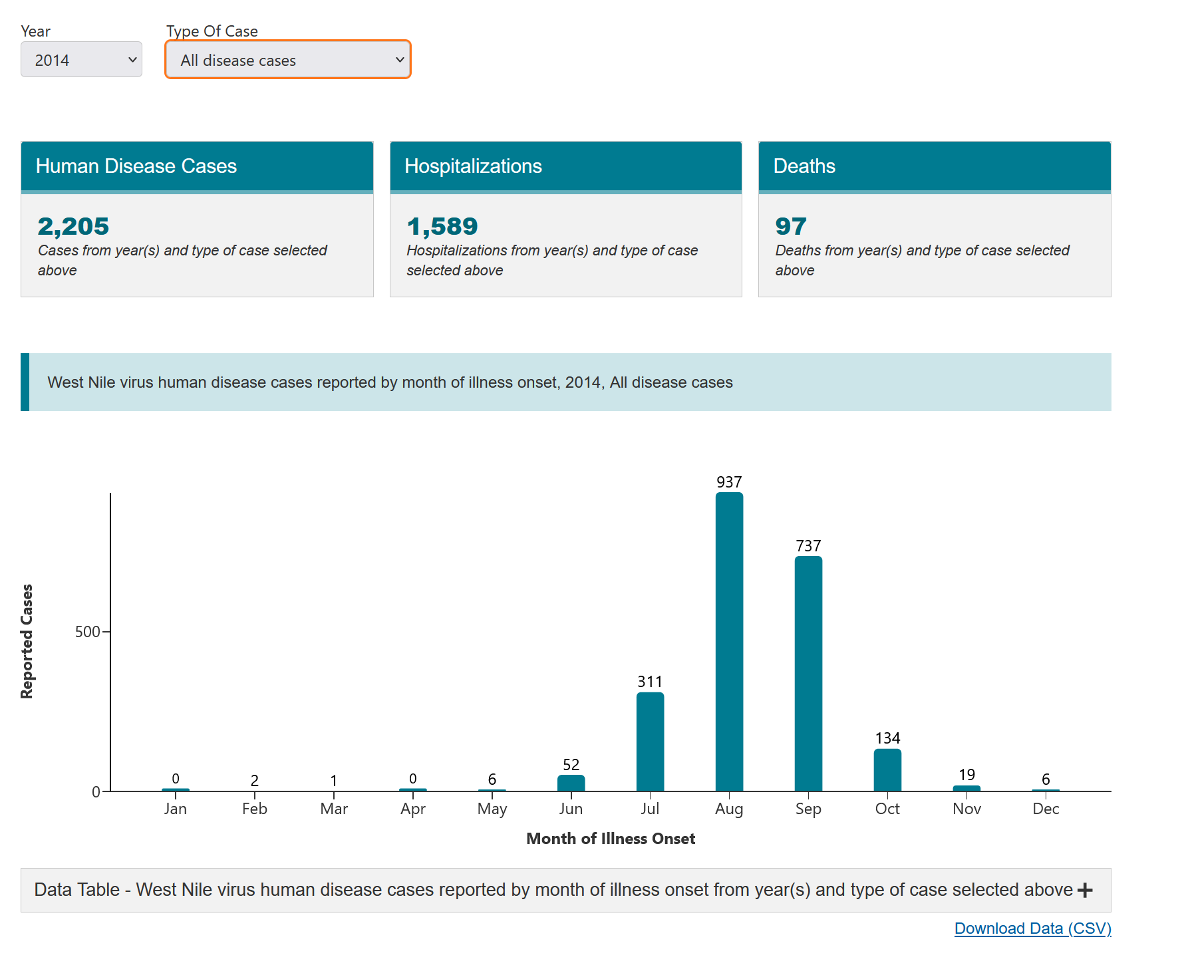

Slide 19
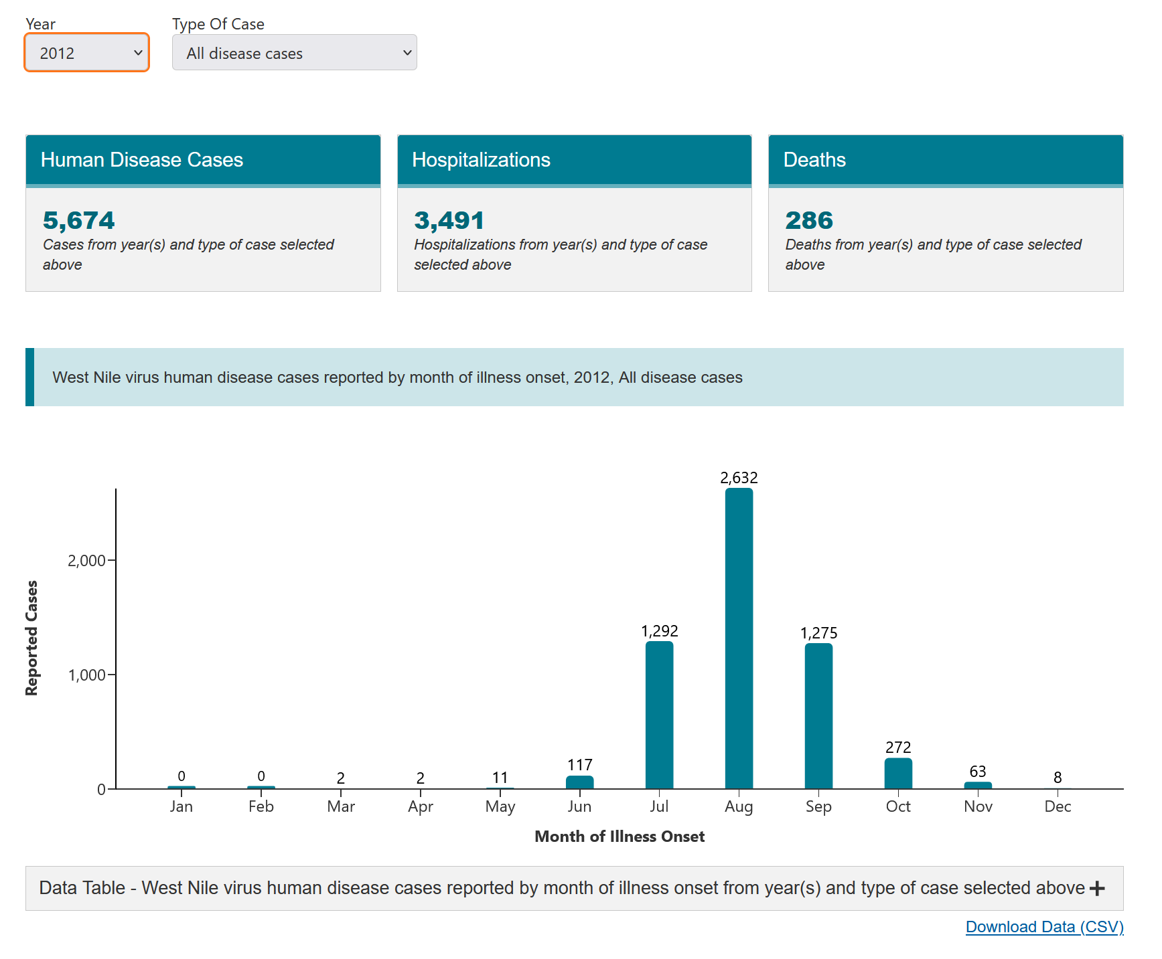

Slide 20
sources
https://www.cdc.gov/west-nile-virus/data-maps/historic-data.html
https://data.world/healthdata/ca-west-nile-virus-cases
https://westnile.ca.gov/faq
www.cdph.ca.gov

